Slide 1
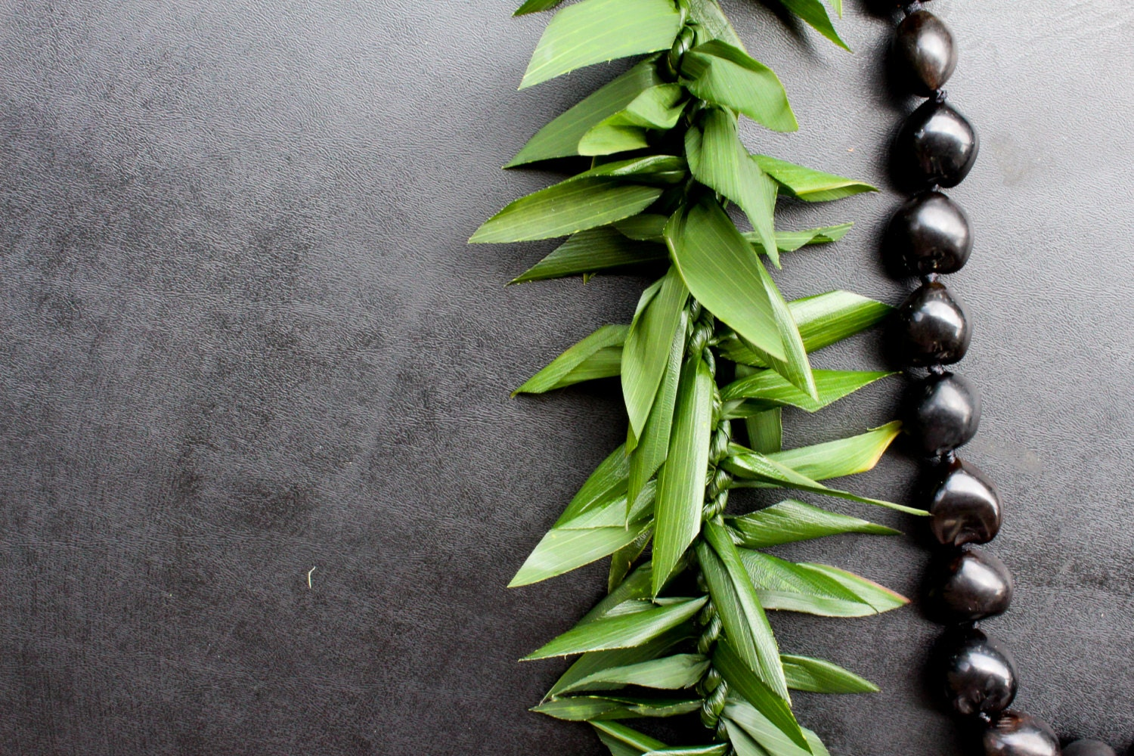

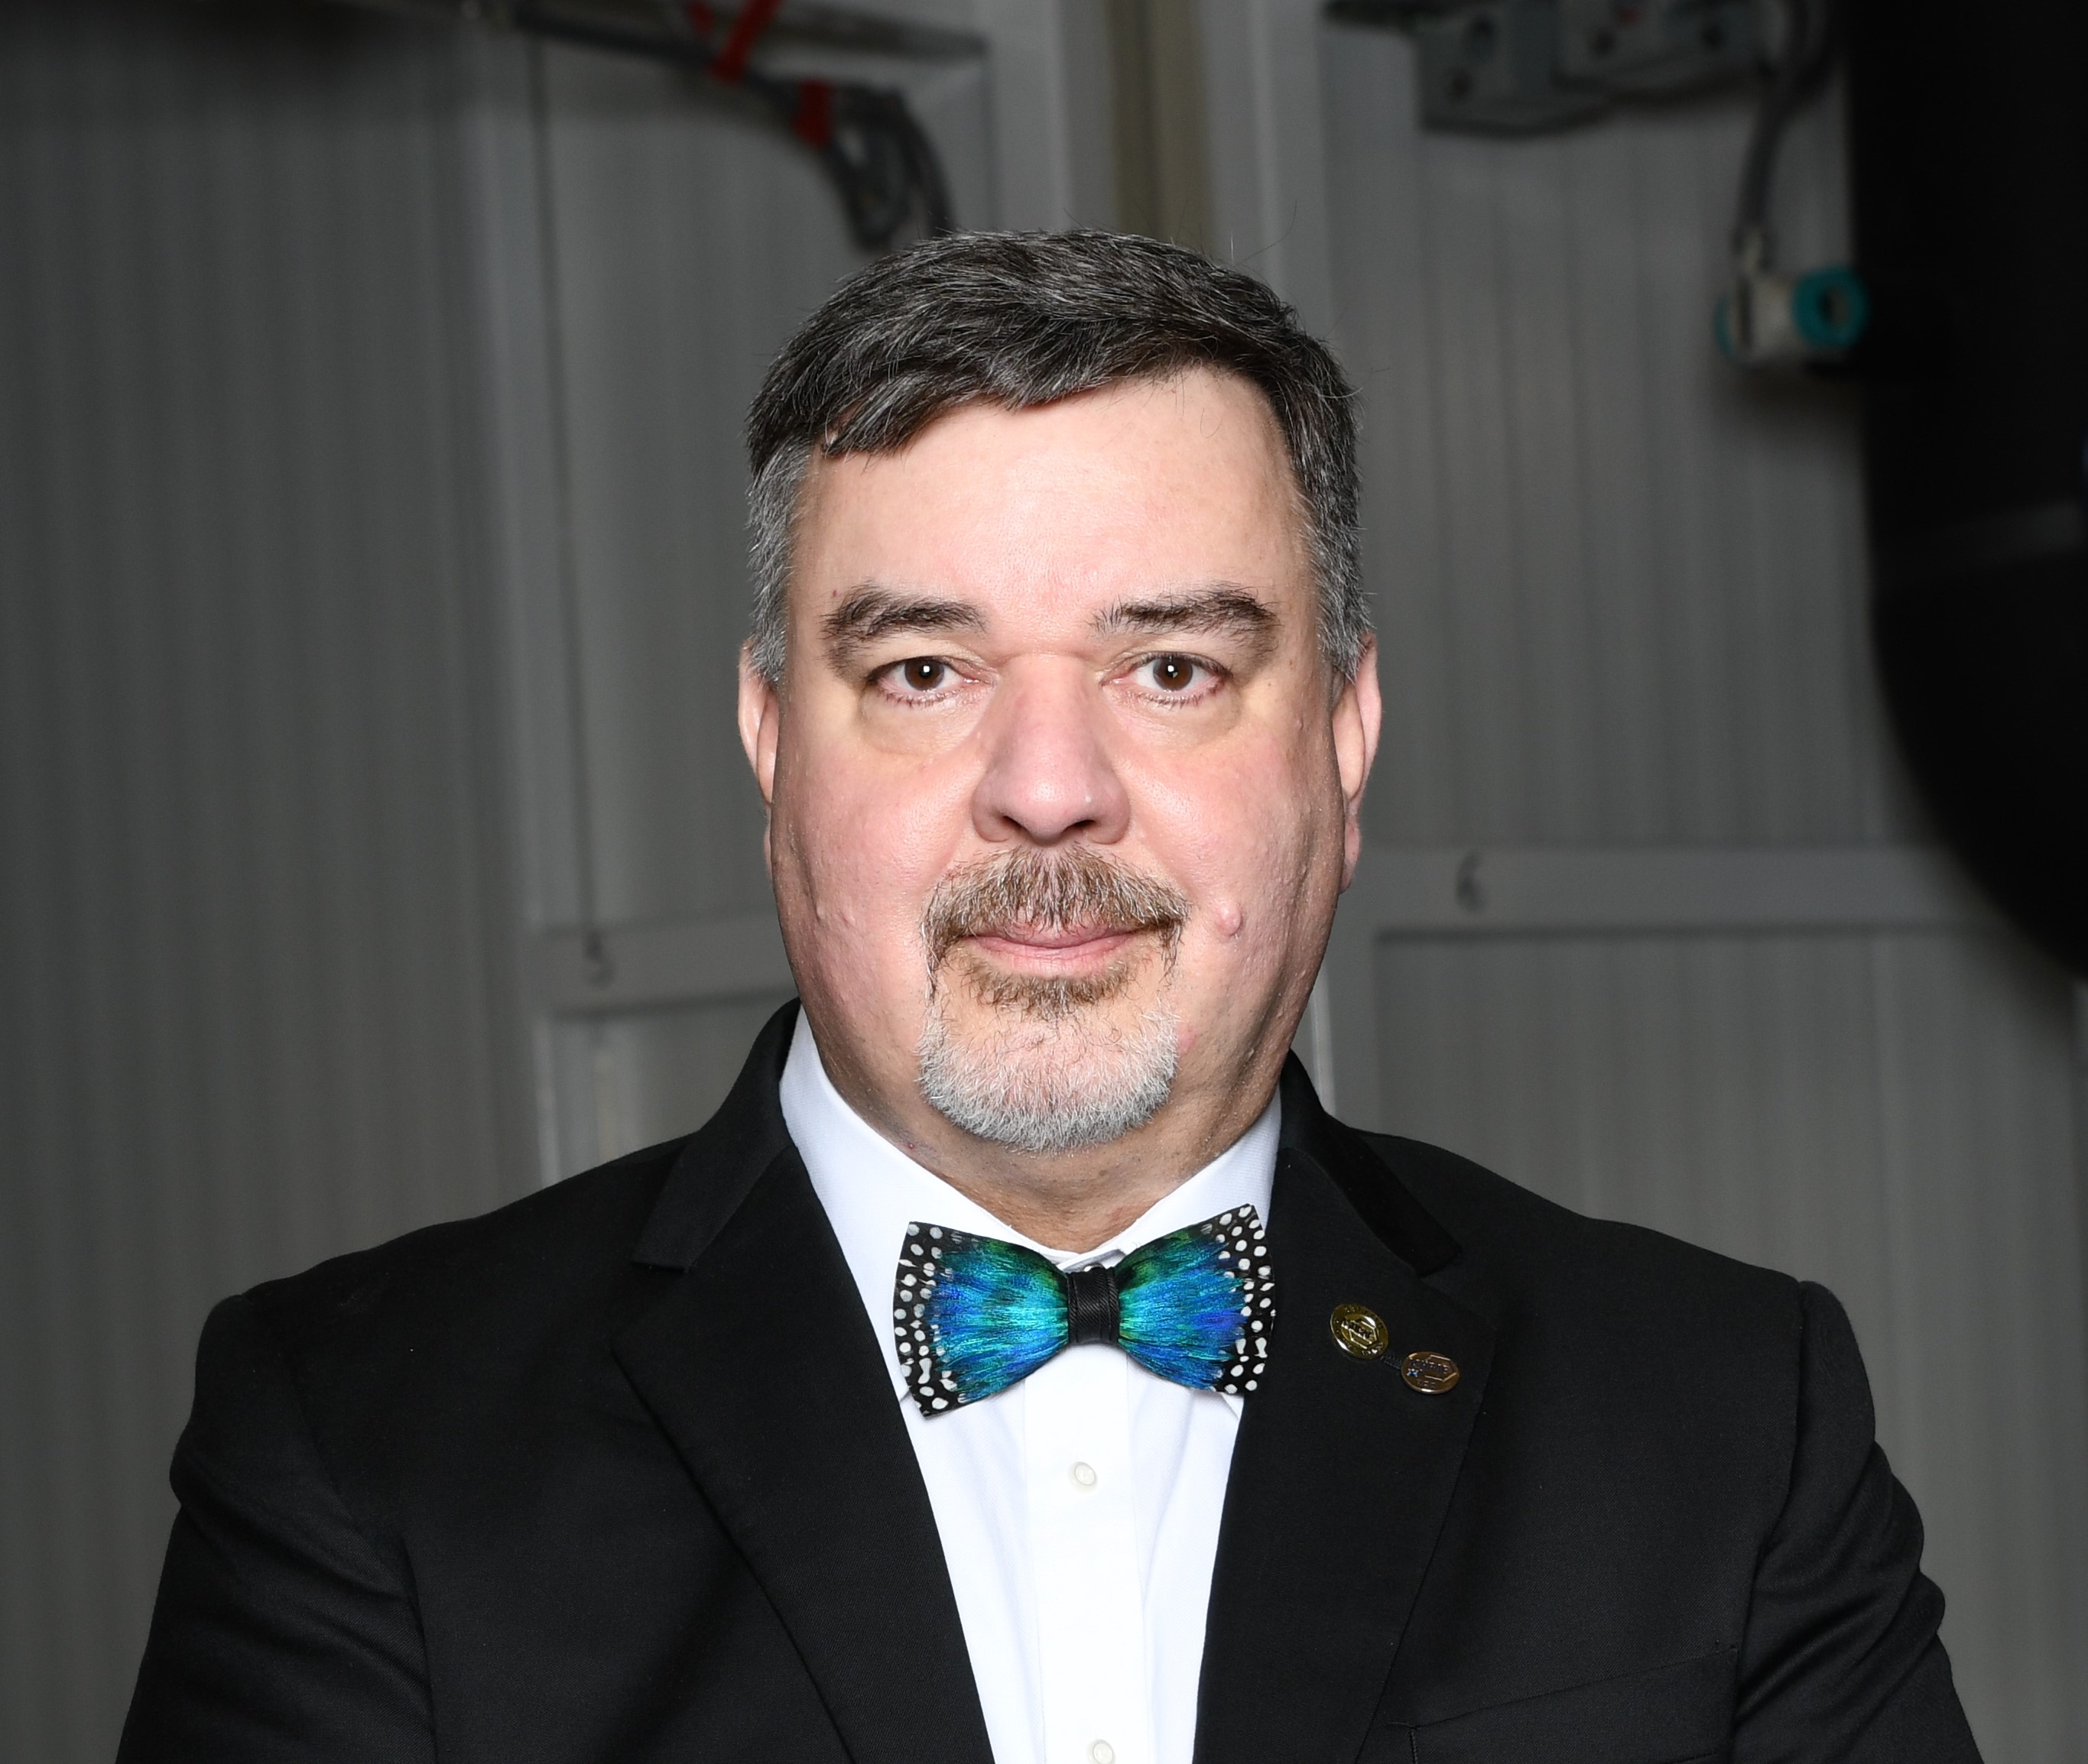
ASHRAE Hawaii Chapter
cordially invites you to a
Meet & Greet
with
Chuck Gulledge
ASHRAE Presidential Member
MONDAY, OCTOBER 4, 2021
5:30pm
TchinTchin
39 N Hotel St, Honolulu, HI
$35/member; $45/non-member; free/student
(No-Host Bar; Under 21yrs old are allowed)
Charles “Chuck” E. Gulledge III P.E., HBDP, LEED AP
2020-21 ASHRAE President
WE NEED STUDENT SPONSORSHIPS!!!
GOLD - $200 SILVER - $150 BRONZE - $100
To register, go to
https://ashraehawaiichapter.info/meetinginfo.php

